Slide 1
Representing Information

Slide 2
Outline
Bit and Byte
Understand machine representations of numbers
Suggested reading
1.1, 2.1.1

Slide 3
Why Bit?
Modern computers store and process
Information represented as two-valued signals
These lowly binary digits are bits(比特)
Bits form the basis of the digital revolution

Slide 4
The Decimal(十进制位的) Representation
Base-10
Has been in use for over 1000 years
Developed in India
Improved by Arab mathematicians in the 12th century
Brought to the West in the 13th century by
the Italian mathematician Leonardo Pisano,
better known as Fibonacci.

Slide 5
Why Bit?
Using decimal notation is natural for ten-fingered humans
But binary values work better when building machines
that store and process information

Slide 6
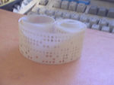
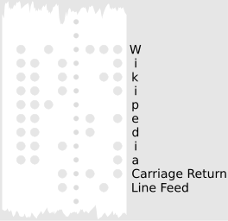
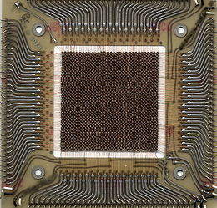
Why Bit?
Two-valued signals can readily be
represented, stored, and transmitted,
Examples
The presence or absence of a hole in a punched card
A high or low voltage on a wire
A magnetic domain oriented clockwise or counterclockwise.
0
1
0
Voltage
Time

Slide 7
Why Bit?
The electronic circuitry is very simple and reliable for
storing and performing computations on two-valued signals
This enabling manufacturers to integrate(集成)
millions of such circuits on a single silicon chip(硅芯片)

Slide 8
Group Bits
In isolation, a single bit is not very useful
In English, there are 26(or 52) characters in its alphabet. They are not useful either in isolation
However, there are plenty of words in its vocabulary. How is this achieved?
Similarly, we are able to represent the elements of any finite set by using bits (instead of bit)

Slide 9
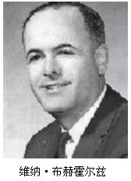
Group Bits
To do this, we
first group bits together
then apply some interpretation to the different possible bit patterns
that gives meaning to each patterns
8-bit chunks are organized as a byte(字节)
Dr. Werner Buchholz in July 1956
during the early design phase for the IBM Stretch computer

Slide 10
Value of Bits
Bits 01010
Value 0*2⁴+1*2³+0*2²+1*2¹+0*2⁰ = 10
Value 102(1100110)
Bits 102 = 51*2 + 0 (0)
51 = 25*2 + 1 (1)
25 = 12*2 + 1 (1)
12 = 6*2 + 0 (0)
6 = 3*2 + 0 (0)
3 = 1*2 + 1 (1)
1 = 0*2 + 1 (1)

Slide 11
Group bits as numbers ⎯ Three encodings(编码)
Unsigned encoding
Representing numbers greater than or equal to 0(>=0)
Using traditional binary representation
Two’s-complement(二进制补码) encoding
Most common way to represent either positive(正数) or negative(负数) numbers
Floating point encoding(浮点编码)
Base-two version of scientific notation for representing real numbers

Slide 12
Group bits as numbers ⎯ Understanding numbers
Machine representation of numbers are not same as
Integers and real numbers
They are finite approximations to integers and real numbers
Sometimes, they can behave in unexpected way

Slide 13
‘int’ is not integer
Overflow(数据过载，溢出)
200*300*400*500 = -884,901,888
Product of a set of positive numbers yielded a negative result
Commutativity(交换律) & Associativity(结合律) remain
(500 * 400) * (300 * 200)
((500 * 400) * 300) * 200
((200 * 500) * 300) * 400
400 * (200 * (300 * 500))

Slide 14
‘float’ is not real number
Product of a set of positive numbers is positive
Overflow and Underflow
Associativity does not hold
(3.14+1e20)-1e20 = 0.0
3.14+(1e20-1e20) = 3.14

Slide 15
Hexadecimal(十六进制)
Base 16 number representation
Use characters ‘0’ to ‘9’ and ‘A’ to ‘F’
Write FA1D37B₁₆ in C as
0xFA1D37B or
0xfa1d37b

Slide 16
Hexadecimal
Byte = 8 bits
Binary 00000000₂ to 11111111₂
Decimal: 0₁₀ to 255₁₀
Hexadecimal 00₁₆ to FF₁₆
Decimal
Hex
Binary
0
0
0000
1
1
0001
2
2
0010
3
3
0011
4
4
0100
5
5
0101
6
6
0110
7
7
0111
8
8
1000
9
9
1001
A
10
1010
B
11
1011
C
12
1100
D
13
1101
E
14
1110
F
15
1111

Slide 17
Hexadecimal vs. Binary
0x173A4C
Hexadecimal 1 7 3 A 4 C
Binary 0001 0111 0011 1010 0100 1100
1111001010110110110011
Binary 11 1100 1010 1101 1011 0011
Hexadecimal 3 C A D B 3
0x3CADB3

Slide 18
Hexadecimal vs. Decimal
Hexadecimal 0xA7
Decimal 10*16+7 = 167
Decimal 314156 = 19634*16 + 12 (C)
19634 = 1227*16 + 2 (2)
1227 = 76*16 + 11 (B)
76 = 4*16 + 12 (C)
4 = 0*16 + 4 (4)
Hexadecimal 0x4CB2C

Slide 19
Hexadecimal vs. Binary
1100100101111011 ->
1001101110011110110101 ->
C97B
2 6 E 7 B 5

Slide 20
Decimal, Hexadecimal, Binary
Decimal Binary Hexadecimal
62
0011 0111
0x52
00111110
0x3E
3*16+7=55
0x37
8*16+8=136
01010010

Slide 21
Hexadecimal
0x503c + 0x8 =
0x503c – 0x40 =
0x503c + 64 =
0x50ea -0x503c =
0x5044
0x4ffc
0x507c
0xae

Slide 22
C Programming Language (1)

Slide 23
Outline
Sample codes
Introduction
Compiler drivers
Assembly code and object code
Suggested reading
1.2

Slide 24
“Hello world” example
1 #include <stdio.h>
2
3 int main()
4 {
5 printf("hello, world\n");
}
Header file
Standard Library

Slide 25
File Inclusion and Macro Substitution
a.c #include “b.h” main() { return i+j ; }
b.h #define i 100 int j ;
int j ;
main()
{
return 100 + j ;
}
Macro Substitution

Slide 26
File Inclusion and Macro Substitution
#include “filename”
#include <filename>
#define forever for(;;) /* infinite loop */
#define square(x) (x)*(x)

Slide 27
Formatted Output - Printf
int printf(char* format, arg1, arg2, …)
int a=1, b=2;
printf(“a=%d, b=%d\n), a, b);
%d, %i decimal number
%o octal(八进制) number(without a leading zero)
%x, %X hexadecimal number
%c single charater

Slide 28
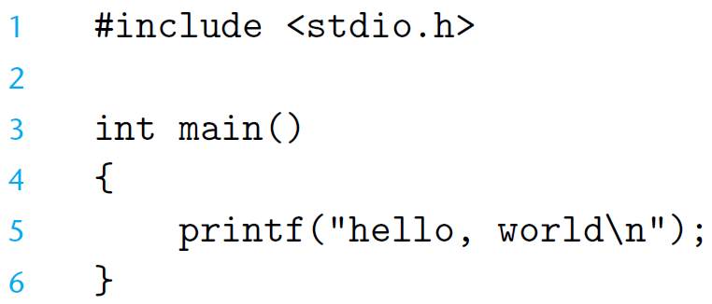
The Hello Program

Slide 29
The Hello Program
Source program
Created by editor and saved as a text file (Consists exclusively of ASCII characters)
Binary file
Not text file
Begins life as a high-level C program
Can be read and understand by human beings
The individual C statements must be translated by compiler drivers
So that the hello program can run on a computer system

Slide 30
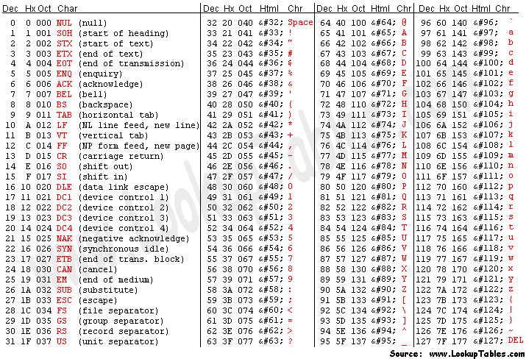
ASCII
American Standard Code for Information Interchange
7-bit encoding of character set
Control Characters
07 \a Bell
08 \b Backspace
09 \t Horizontal Tab
0A \n Line feed
0B \v Vertical Tab
0C \f Form feed
0D \r Carriage return

Slide 31
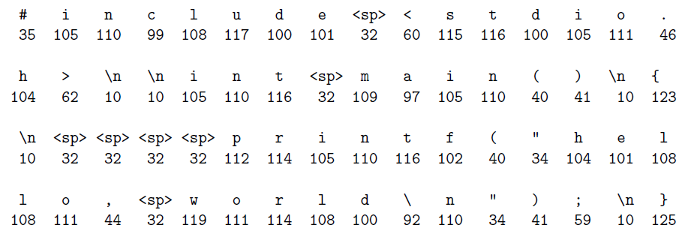
The Hello Program

Slide 32
The Hello Program
The C programs are translated into
A sequence of low-level machine-language instructions
These instructions are then packaged in a form
called an object program
Object program are stored as a binary disk file
Also referred to as executable object files

Slide 33
The Context of a Compiler (gcc)
hello.c
Source program (text)
Preprocessor (cpp)
hello.i
Modified source program (text)
Compiler (cc1)
hello.s
Assembly program (text)
Assembler (as)
hello.o
Relocatable object program (binary)
Linker (ld)
hello
Executable object program (binary)

Slide 34
Preprocessor
Macro Substitution
a.c #include “b.h” main() { return i+j ; } | b.h #define i 100 int j ;
# 1 "a.c"
# 1 "<built-in>"
# 1 "<command-line>"
# 1 "a.c"
# 1 "b.h" 1
int j;
# 2 "a.c" 2
main()
{
return 100 +j ;
}
Obtain with command
gcc -E a.c
Source file a.i

Slide 35
Source Code and Assembly Code
//C code long mult2(long, long); void multstore(long x, long y, long *dest) { long t = mult2(x, y); *dest = t; }
Obtain with command gcc –Og -S mstore.c | Assembly file mstore.s multstore: pushq %rbx movq %rdx,%rbx call mult2 movq %rax, (%rbx) popq %rbx ret

Slide 36
Relocatable Object Code
53 48 89 d3 e8 00 00 00 00 48 89 03 5b c3 | Obtain with command gcc –Og -c mstore.c Relocatable object file mstore.o

Slide 37
Executable Object Code
#include <stdio.h> void mulstore(long, long, long*) int main() { long d; multstore(2, 3, &d); printf(“2 * 3 --> %d\n”, d); return 0; } long mult2(long a, long b) { long s = a * b ; return s; } | 53 48 89 d3 e8 42 00 00 00 48 89 03 5b c3
 | Obtain with command gcc –Og –o prog main.c mstore.c

Slide 38
COMPILING
C Program Preprocessor
Source Codes [*.i]
C Program Compiler
Source Codes [*.c, *.h]
E
S
GNU Compiler Collection
Assembly Codes [*.s]
Binary Codes [*.out]
c
o
Binary Codes [*.o]
Linker
Assembler

Slide 39
Manipulating Information

Slide 40
Outline
Bit-level operations
Suggested reading
2.1.6~2.1.9

Slide 41
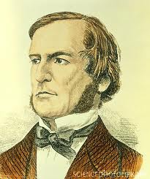
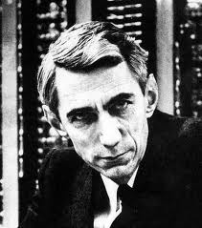
Boolean Algebra
Developed by George Boole(1815-1864)
Algebraic representation of logic
Encode “True” as 1
Encode “False” as 0
Claude Shannon(1916–2001)founded the information theory
made the connection between Boolean algebra and digital logic
Plays a central role in the design and analysis of digital systems

Slide 42
Boolean Algebra
And
A&B = 1 when both A=1 and B=1
Or
A|B = 1 when either A=1 or B=1
Not
~A = 1 when A=0
Exclusive-Or (Xor)
A^B = 1 when either A=1 or B=1, but not both

Slide 43
General Boolean Algebras
Operate on Bit Vectors
Operations applied bitwise
01101001
& 01010101
01000001
01101001
| 01010101
01111101
01101001
^ 01010101
00111100
~ 01010101
10101010

Slide 44
General Boolean Algebras
Representation of Sets
Width w bit vector represents subsets of {0, …, w–1}
a_{j} = 1 if j ∈ A
01101001 { 0, 3, 5, 6 }
01010101 { 0, 2, 4, 6 }
& Intersection 01000001 { 0, 6 }
| Union 01111101 { 0, 2, 3, 4, 5, 6 }
^ Symmetric difference 00111100 { 2, 3, 4, 5 }
~Complement 10101010 { 1, 3, 5, 7 }
相关的联想：一个int 32bits，英文字母有26个，
所以可以考虑取出一个int的低26位表示出现次数(每次取异或)

Slide 45
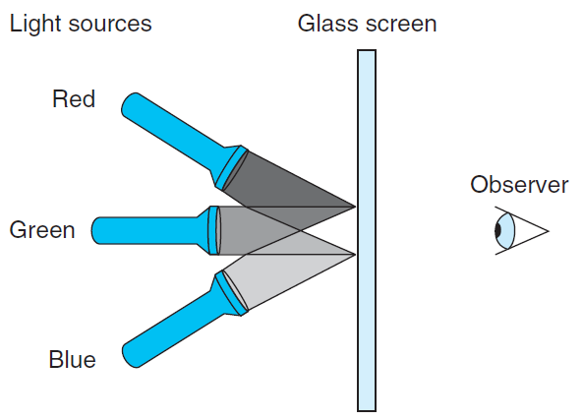
RGB Color Model

Slide 46
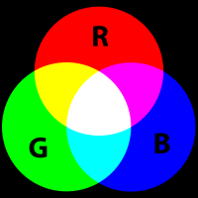
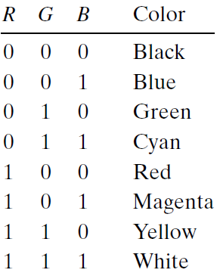
RGB Color Model
Magenta
Cyan

Slide 47
Bit-Level Operations in C
Operations &, |, ~, ^ Available in C
Apply to any “integral” data type
long, int, short, char
View arguments as bit vectors
Arguments applied bit-wise

Slide 48
Bit-Level Operations in C
~0x41 | 0xBE
~0x00 | 0xFF
0x69 & 0x55 | 0X41
0x69 | 0x55 | 0x7D
~0100 0001
1011 1110
~0000 0000
1111 1111
0110 1001 & 0101 0101
0100 0001
0110 1001 | 0101 0101
0111 1101

Slide 49
Cool Stuff with Xor
Bitwise Xor is form of addition
With extra property that every value is its own additive inverse
A ^ A = 0

Slide 50
Cool Stuff with Xor
int inplace_swap(int *x, int *y)
{
*x = *x ^ *y; /* #1 */
*y = *x ^ *y; /* #2 */
*x = *x ^ *y; /* #3 */
}

Slide 51
Cool Stuff with Xor
1 void reverse_array(int a[], int cnt) {
2 int first, last;
3 for (first = 0, last = cnt-1;
4 first <= last;
5 first++,last--)
6 inplace_swap(&a[first], &a[last]);
7 }

Slide 52
Mask Operations
Bit pattern
0xFF
Having 1s for the least significant eight bits
Indicates the lower-order byte of a word
Mask Operation
X = 0x89ABCDEF
X & 0xFF =?
Bit Pattern ~0
Why not 0xFFFFFFFF?

Slide 53
Mask Operations
Write C expressions that work for any word size w ≥ 8
For x = 0x87654321, with w = 32
The least significant byte of x, with all other bits set to 0
[0x00000021]
x & 0xFF

Slide 54
Mask Operations
All but the least significant byte of complemented, with the least significant byte left unchanged
[0x789ABC21]
The least significant byte set to all 1s, and all other bytes of x left unchanged.
[0x876543FF].
x ^ ~0xFF
x | 0xFF

Slide 55
Logical Operations in C
Logical Operators
&&, ||, !
View 0 as “False”
Anything nonzero as “True”
Always return 0 or 1
Early termination (short cut)

Slide 56
Logical Operations in C
Examples (char data type)
!0x41 --> 0x00
!0x00 --> 0x01
!!0x41 --> 0x01
0x69 && 0x55 --> 0x01
0x69 || 0x55 --> 0x01

Slide 57
Short Cut(短路逻辑) in Logical Operations
a && 5/a
If a is zero, the evaluation of 5/a is stopped
avoid division by zero
p && *p
Never cause the dereferencing of a null pointer
Using only bit-level and logical operations
Implement x == y
it returns 1 when x and y are equal, and 0 otherwise
!(x^y)

Slide 58
Shift Operations in C
Left Shift: x << y（逻辑左移）
Shift bit-vector x left y positions
Throw away extra bits on left
Fill with 0’s on right
Argument x
01100010
<< 3
00010000
Argument x
10100010
<< 3
00010000

Slide 59
Shift Operations in C
Right Shift: x >> y
Shift bit-vector x right y positions
Throw away extra bits on right
Logical shift
Fill with 0’s on left
Arithmetic shift
Replicate most significant bit on right
Useful with two’s complement integer representation (especially for the negative number )
Argument x
01100010
Log. >> 2
00011000
Arith. >> 2
00011000
Argument x
10100010
Log. >> 2
00101000
Arith. >> 2
11101000
C默认是算术右移(看移动之前的最高位来决定补的数字)

Slide 60
Shift Operations in C
What happens ?
int lval = 0xFEDCBA98 << 32;
int aval = 0xFEDCBA98 >> 36;
unsigned uval = 0xFEDCBA98u >> 40;
It may be
lval 0xFEDCBA98 (0)
aval 0xFFEDCBA9 (4)
uval 0x00FEDCBA (8)
Be careful about
1<<2 + 3<<4 means 1<<(2 + 3)<<4
gcc默认移动超过32位会mod32取模

Slide 61
bitCount
Returns number of 1's a in word
Examples: bitCount(5) = 2, bitCount(7) = 3
Legal ops: ! ~ & ^ | + << >>
Max ops: 40

Slide 62
Sum 8 groups of 4 bits each
int bitCount(int x) {
int m1 = 0x11 | (0x11 << 8);
int mask = m1 | (m1 << 16);//掩码操作
int s = x & mask;(看0 4 8 12 16 20 24 28是否是1)
s += x>>1 & mask;
s += x>>2 & mask;
s += x>>3 & mask;

Slide 63
Combine the sums
/* Now combine high and low order sums */
s = s + (s >> 16);
/* Low order 16 bits now consists of 4 sums.
Split into two groups and sum */
mask = 0xF | (0xF << 8);
s = (s & mask) + ((s >> 4) & mask);
return (s + (s>>8)) & 0x3F;
}

